Slide 1

PCTO
Fattori jacopo
5am
A.s.2024/2025

Slide 2
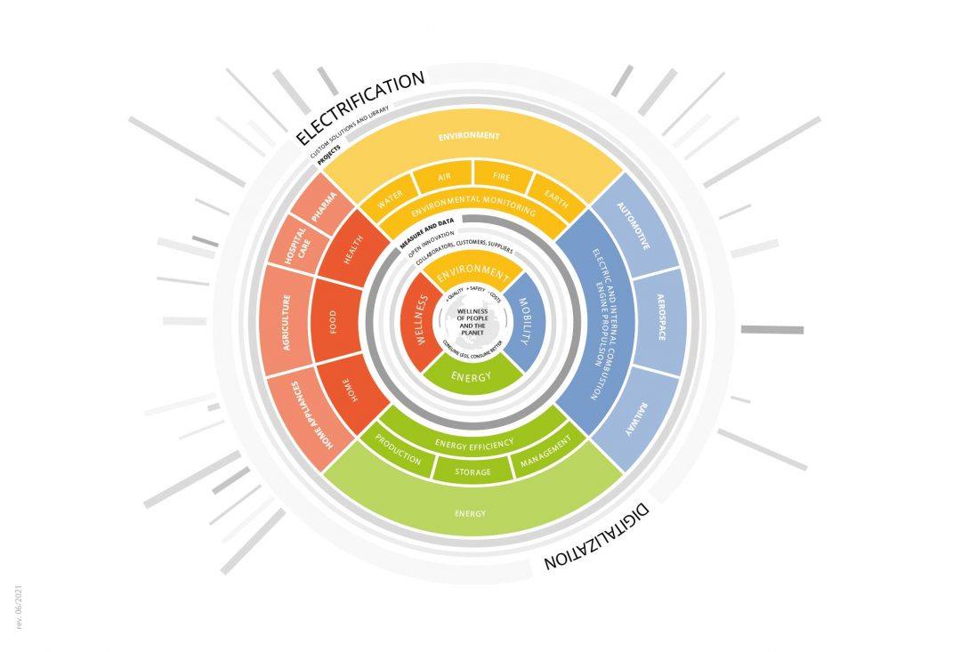
WHAT IS LOCCIONI?
It is a company founded in 1968 by Enrico Loccioni and initially dealt with industrial electrical systems. From the 90s, it expanded to many other fields like: the healthcare, environment and mobility.
Loccioni is currently a leading company in the creation of solutions and projects in more than 40 countries around the world.
“Polaris”, graphic representation of the company's mission: “The wellness of people and the planet”

Slide 3
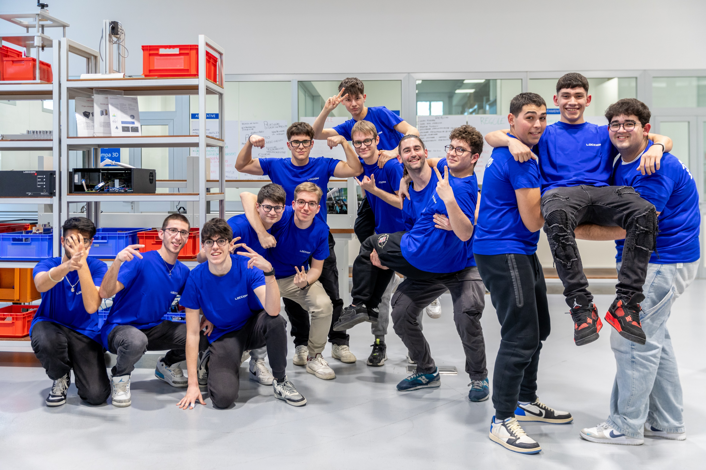
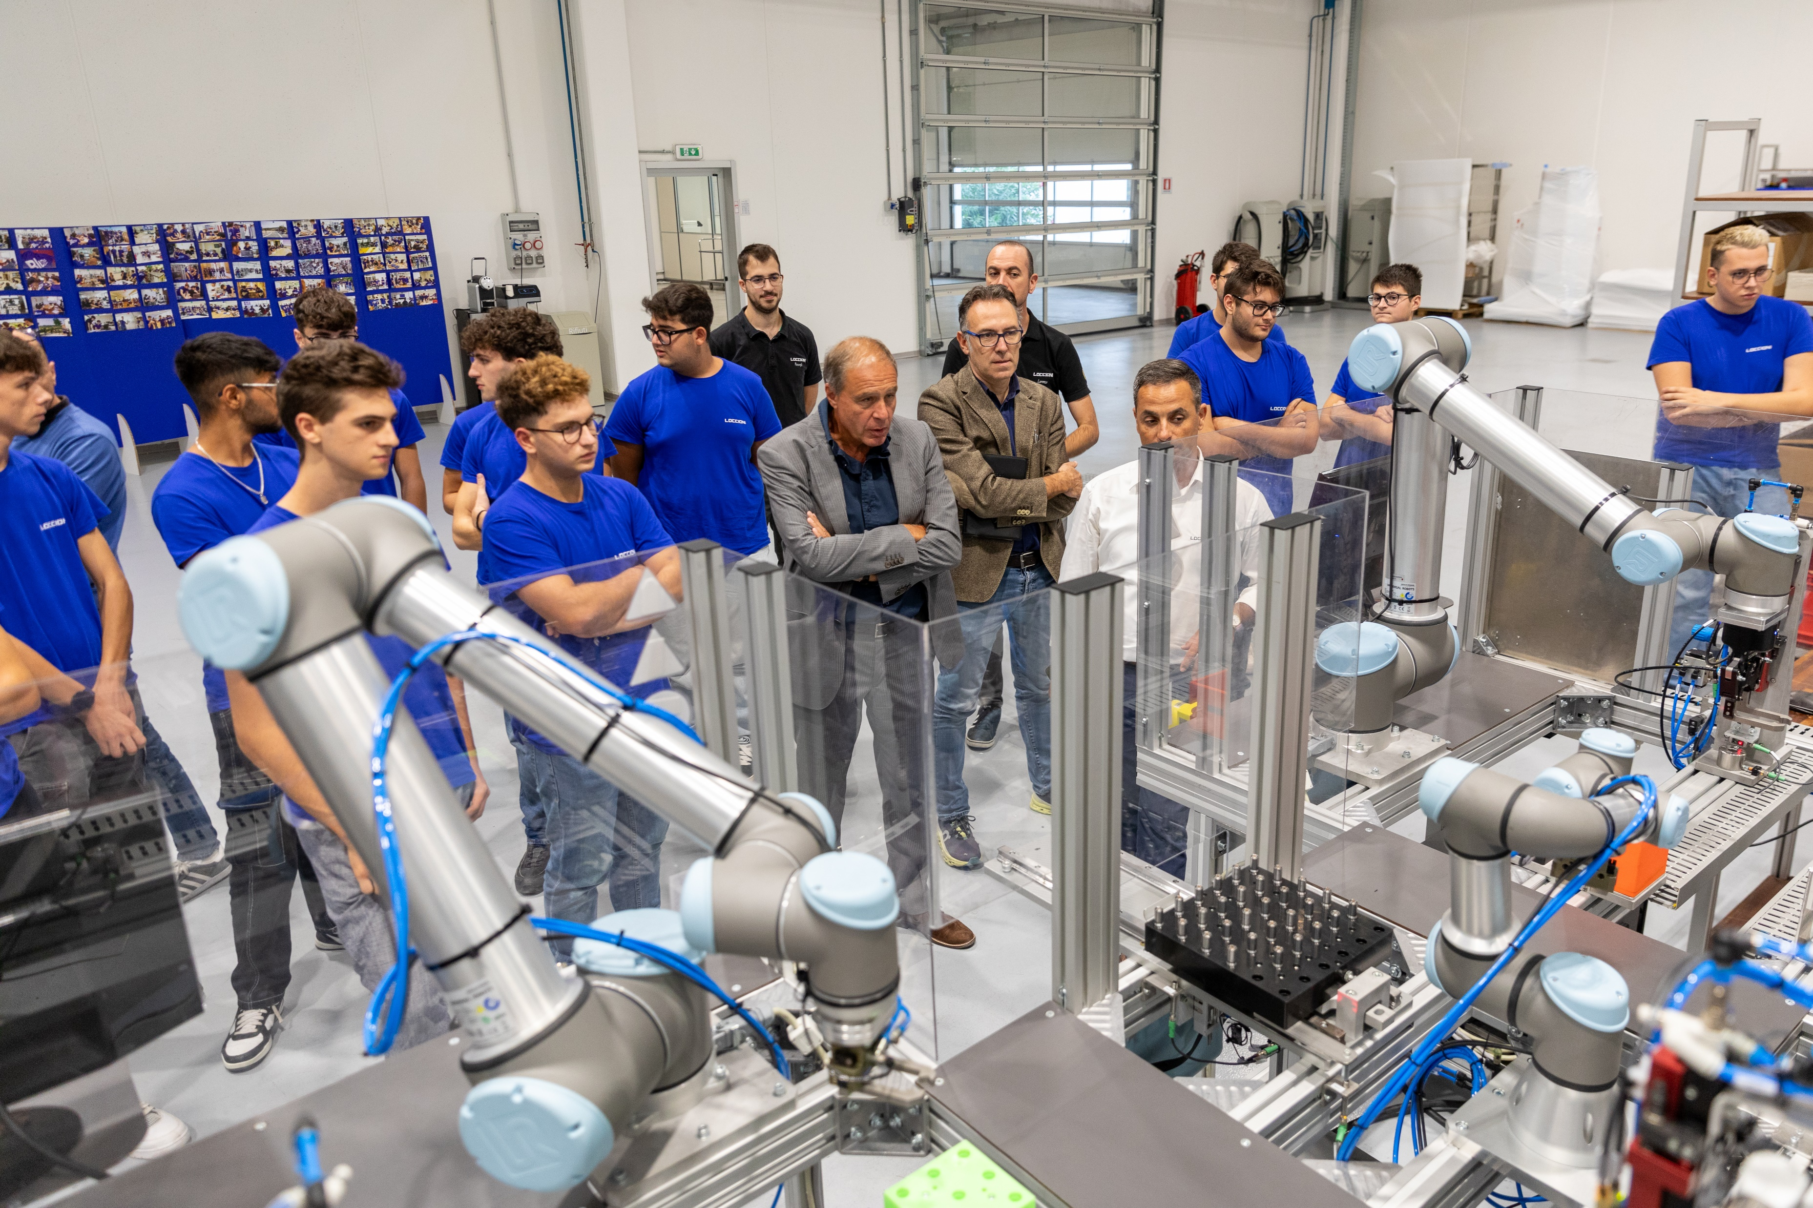
INTERNSHIP PERIOD
Between March 16th and May 18th we had the opportunity to get initial training on all the skills the company works on and to learn more about what Loccioni does.
From May 20th to June 7th and from September 9th to September 20th, we had the opportunity to work, as an independent team, in the development of an injector test bench, whose goal was to separate the good ones from the bad ones.

Slide 4
PERSONAL REFLECTION ON THE WORKING ENVIROMENT
The work environment game me the chance to further develop my ability to work in a team, which is a fundamental element in the world of work. Working in a team allowed me to understand the weight of meeting deadlines in at a project and the difficulties that can arise during its development, as well as the responsibilities that must be taken on.

Slide 5
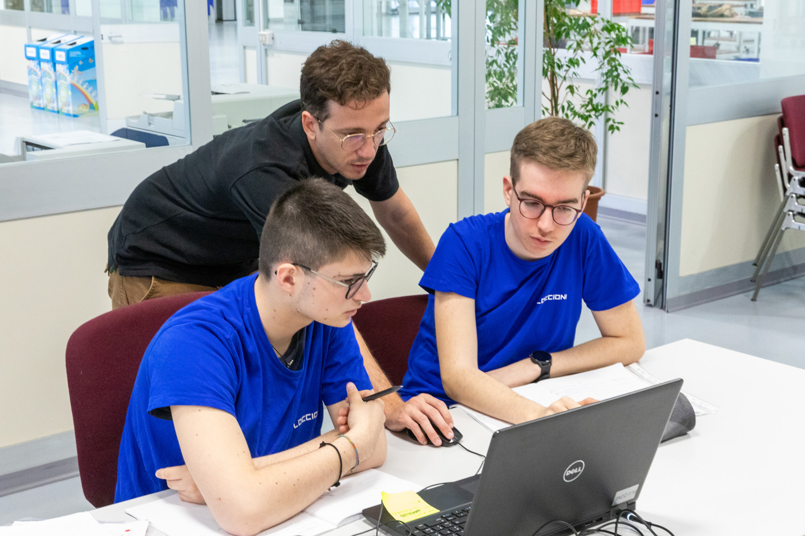
INITIAL EXPECTATIONS AND THOUGHTS ON THE FUTURE
The internship period managed to meet my expectations, in fact I had the opportunity to put into practice my IT knowledge, to learn how to carry out tasks that involve other skills (mechanical and electronical skills), and to have the opportunity to have a project to which to dedicate our time.
This also made me realize that I still have a lot to learn, and I will probably continue my studies in computer science.

Slide 6
PROS AND CONS
PROS:
The possibility to work independently on a project;
I was able to use my computer skills;
I was able to learn the basics of other skills;
Positive working environment;
Working in a team.
CONS:
Poor training in using the company's software development environment.

Slide 7
CONCLUSIONS
In conclusion, I believe that the experience gave me the possibility to grow in terms of skills but also on a personal level (precisely) I was able to understand the responsibilities that you have when one you work, in addition to how important it is for me to continue my studies.

Slide 8

THANKS FOR WATCHING!

